Slide 1
Apache Hadoop works on Data Locality principle which states that move computation to data instead of data to computation, this reduces network congestion and therefore, enhances the overall system throughput.
HDFS Throughput - Throughput is the amount of work done in a unit time
In hadoop, the task is divided among different blocks, the processing is done parallel and independent to each other. so because of parallel processing, HDFS has high throughput.
HDFS Advantage:
Support the storage of massive data.
Detect and quickly respond to hardware failures.
Streaming data access.
Simplified consistency model.
High fault tolerance.
Commercial hardware.
HDFS Disadvantage:
Can not achieve low-latency data access.
Not suitable for a large number of small file storage.
File modification is not supported (HDFS 2.x supports appending content to files).
Parallel writing by users is not supported.

Slide 2
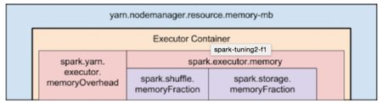
Distribution of Executors, Cores and Memory for a Spark Application running in Yarn
Following list captures some recommendations to keep in mind while configuring them:
Hadoop/Yarn/OS Deamons: When we run spark application using a cluster manager like Yarn, there’ll be several daemons that’ll run in the background like NameNode, Secondary NameNode, DataNode, JobTracker and TaskTracker. So, while specifying num-executors, we need to make sure that we leave aside enough cores (~1 core per node) for these daemons to run smoothly.
Yarn ApplicationMaster (AM): ApplicationMaster is responsible for negotiating resources from the ResourceManager and working with the NodeManagers to execute and monitor the containers and their resource consumption. If we are running spark on yarn, then we need to budget in the resources that AM would need (~1024MB and 1 Executor).
HDFS Throughput: HDFS client has trouble with tons of concurrent threads. It was observed that HDFS achieves full write throughput with ~5 tasks per executor . So it’s good to keep the number of cores per executor below that number.
MemoryOverhead: Following picture depicts spark-yarn-memory-usage.
So, if we request 20GB per executor, AM will actually get 20GB + memoryOverhead = 20 + 7% of 20GB = ~23GB memory for us.
Running executors with too much memory often results in excessive garbage collection delays.
Running tiny executors (with a single core and just enough memory needed to run a single task, for example) throws away the benefits that come from running multiple tasks in a single JVM.
Two things to make note of from this picture:
Full memory requested to yarn per executor = spark-executor-memory + spark.yarn.executor.memoryOverhead. spark.yarn.executor.memoryOverhead = Max(384MB, 7% of spark.executor-memory)

Slide 3
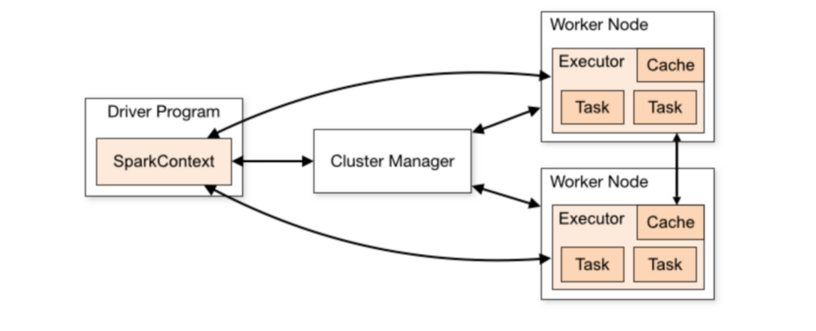
Spark Driver Functions:
Creates SparkContext object
Connection to the cluster is made,
resources are requested,
job is broken down into stages and then further into tasks (schedule and launch tasks on executors).
Defines the transformations and actions applied on the dataset
Driver first requests application master to allocate resources for the containers on the worker nodes. Once allocated by the AM, driver starts communicating with Executors in worker nodes and assign tasks to them.
Through the sparkcontext object it initiated it acquires executors on nodes in the cluster. Next it sends application code to the executors. Finally, tasks are sent to the executors.
Executor:
JVM process responsible for execution of tasks. Many tasks can run in parallel in a single process. These executors stick around in memory for the entire liftime of the spark application, even when no jobs are running. Due to this the app takes up the fixed allotment of resources during the entire duration.

Slide 4
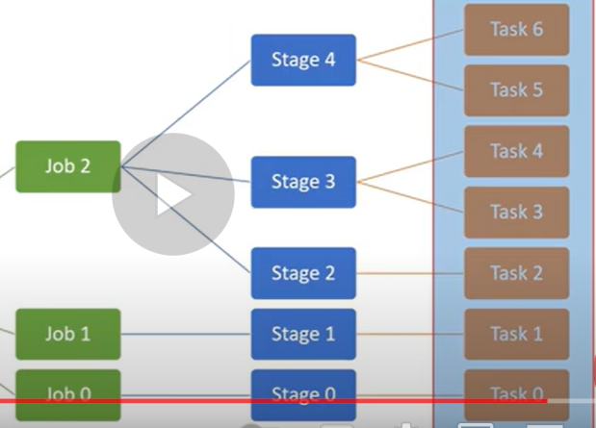
Stages and Tasks
Driver
Spark context object
Executor
ShuffleMapStage - Map
ResultStage – Reduce – initiated by action

Slide 5
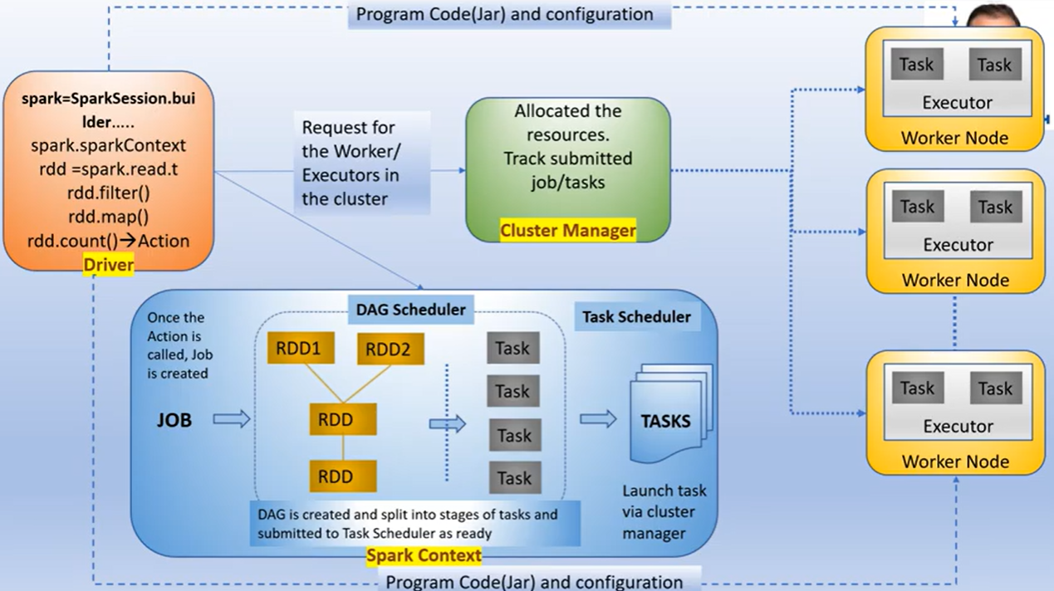

Slide 6
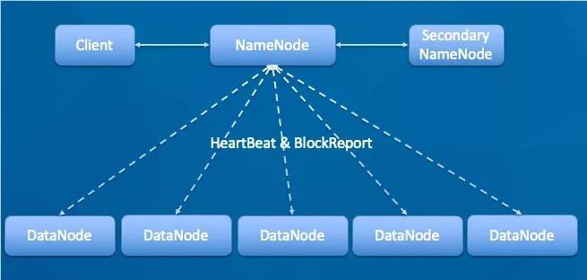
NameNode: It is the master node.
HTTP port is 50700
RPC port is 8020, somebody will reconfigure to 9000 the metadata of the file is stored in the memory of the NameNode
Manage the namespace of HDFS. Management data block (block) mapping information(Metadata of the files is maintained in memory)
Configure the copy policy. Handle the client's read and write requests.
DataNode: The NameNode issues the command, and the
DataNode performs the actual operation. Stores the actual data block. Perform data block read/write operations.
-Will report to the NameNode every 3 seconds – heartbeat -SSH(secured shell protocol) is used for communication to NameNode using port 22

Slide 7
Spark.executor.memory – is divided into
spark.shuffle.memoryFraction – used to contain data related to shuffle or other intermediate outputs and
spark.storage.memoryFraction – used to store the user defined data
Apart from allocated memory, 7% of memory is allocated on top of that to the cluster manager i.e. YARN. You can explicitly set the overhead memory allocated.
--num-executors =
--executor-cores = decides the number of tasks running in that executor in parallel
--executor-memory =
Got HDFS throughput it is recommended to use 4 to 5 executor-cores
A thin executor which means that has lesser number of tasks will be under utilised.
Spark OOM:
2 types
Driver OOM
Executor OOM
Notes:
Spark.executor.memory – is divided into
spark.shuffle.memoryFraction – used to contain data related to shuffle or other intermediate outputs
and
spark.storage.memoryFraction – used to store the user defined data
Apart from allocated memory, 7% of memory is allocated on top of that to the cluster manager i.e. YARN. You can explicitly set the overhead memory allocated.
--num-executors =
--executor-cores = decides the number of tasks running in that executor in parallel
--executor-memory =
Got HDFS throughput it is recommended to use 4 to 5 executor-cores
A thin executor which means that has lesser number of tasks will be under utilised.
Spark OOM:
2 types
Driver OOM
Executor OOM
Driver OOM – Collect operation triggers. This happens when the files from different executors are merged in the driver, and if the file size exceeds the allocated size.
Broadcast join – Assume there are files sitting in executors and 2 smaller files are in two other machine. If 2 files were decided to be broadcasted, they will be sent to driver for merging where suppose the size of the resulting file exceeds the memory, results in OOM.
Avoid this by
increasing the driver memory using spark.driver.memory (default 1 GB)
Reduce the threshold limit for the broadcast table.
Executor OOM – A Node will be assigned certain memory which in turn will have executor container. Within that an executor container will be having YARN memory overhead + Executor Memory(storage memory, execution memory). Whenever Executor OOM happens it is mostly the YARN memory overhead running short of the capacity. Off-heap memory part of executor that accommodates, internal strings are created (in the form of hash table), spark internal objects, if other than Scala is used for programming all the language objects are stored here. Usually YARN memory overhead is 10% of memory assigned to your executor. This has to be proportionately increased in respect to the memory requirement raise of executor (YARN killed the container breaching the memory limits error, then increase the YARN memory overhead part using spark.driver.memoryOverhead (From AWS pages :- By default, memory overhead is set to either 10% of executor memory or 384, whichever is higher. Memory overhead is used for Java NIO direct buffers, thread stacks, shared native libraries, or memory mapped files.)

Slide 8

Driver OOM:
Collect() - After processing the files in various executors, to merge the results, collect() operation is called on the dataframe. As soon as the collect() is called Spark will try to collect all the files in the driver, try to merge it into a single file. Now the resulting file may be a bigger one breeching the memory capacity of the driver resulting in OOM.
Avoid this by
increasing the driver memory using spark.driver.memory (default 1 GB)
Reduce the threshold limit for the broadcast table.
Executor
Part-1
Collect()
Driver
Executor
Part-2
Executor
Part-3

Slide 9
Broadcast join – Assume there are files sitting in executors and 2 smaller files are in two other machine. If 2 files were decided to be broadcasted (in order to avoid shuffling), they will be sent to driver for merging where suppose the size of the resulting file exceeds the memory, results in OOM.
Executor
Part-1
Broadcast()
Driver
Executor
Part-2
Executor
Part-3

Slide 10
Driver OOM:
Collect operation triggers. This happens when the files from different executors are merged in the driver, and if the file size exceeds the allocated size.
Broadcast join – Assume there are files sitting in executors and 2 smaller files are in two other machine. If 2 files were decided to be broadcasted, they will be sent to driver for merging where suppose the size of the resulting file exceeds the memory, results in OOM.
Avoid this by
increasing the driver memory using spark.driver.memory (default 1 GB)
Reduce the threshold limit for the broadcast table.
Executor OOM: A Node will be assigned certain memory which in turn will have executor container. Within that an executor container will be having YARN memory overhead + Executor Memory(storage memory, execution memory). Whenever Executor OOM happens it is mostly the YARN memory overhead running short of the capacity. Off-heap memory part of executor that accommodates, internal strings are created (in the form of hash table), spark internal objects, if other than Scala is used for programming all the language objects are stored here. Usually YARN memory overhead is 10% of memory assigned to your executor. This has to be proportionately increased in respect to the memory requirement raise of executor (YARN killed the container breaching the memory limits error, then increase the YARN memory overhead part using spark.driver.memoryOverhead (From AWS pages :- By default, memory overhead is set to either 10% of executor memory or 384, whichever is higher. Memory overhead is used for Java NIO direct buffers, thread stacks, shared native libraries, or memory mapped files.)

Slide 11
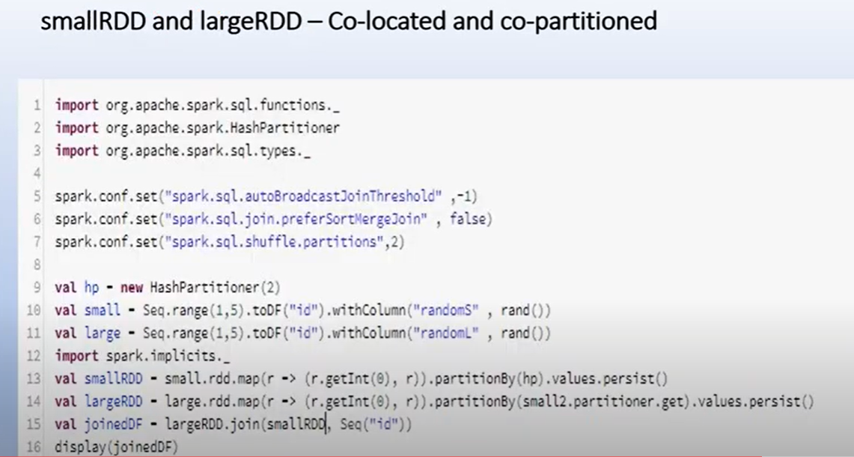
What decides the stages in a spark job?
Stages are created depending on the wide transformations
Spark join without shuffle
Co-locate the RDDs with the joing keyes in the same partition. And this can only happen only if two RDDs can
The same partitioner (hash, hashmap, range partitioner)
were shuffled as part of the same action. Joining keys located in the same partition results in narrow transformation.
SortMergeJoin is the Spark default
Notes:
What decides the stages in a spark job?
Stages are created depending on the wide transformations. Usually s
./bin/spark-submit \ --master <master-url>
\ --deploy-mode <deploy-mode>
\ --conf <key<=<value>
\ --driver-memory <value>g
\ --executor-memory <value>g
\ --executor-cores <number of cores>
\ --jars <comma separated dependencies> --class <main-class>
\ <application-jar>
\ [application-arguments]huffling leads to wide transformations.
--num-executors
--executor-memory
--executor-cores
--driver-memory
Executors are JVMs, they created tasks(tasks are your code that works on the input data. The tasks usually executes in parallel fashion, the number of tasks simultaneously executed is the value assigned to --executor-cores. Core is nothing but CPU allocation for a task. Take note that if the resource available is less than what was assigned to the cores, though the tasks were created matching the value, tasks executed in parallel will be matching the resource availability. The size of resource is defined by –executor-memory. The value “--num-executors” is the executors the job require to finish the task and the number of executors are created are per cluster and not per node.)
How executors are created in the worker nodes ?
A single node can have multiple executors.
--driver-memory – sparksubmit creates a driver. Upon creation, the driver if spark, communicates to the master, if YARN then to application master. Driver will co-ordinate with the jobs executing on the worker node. Collect() or Take() will make the driver to collect complete data from all the worker nodes. This is when the if the data size exceeds the driver memory, will trigger the Driver OOM exception.
SaveAsTextFile() – this will run in parallel and not staging data in driver.

Slide 12
2.3 Driver and Executor Resources (Cores & Memory)
While submitting an application, you can also specify how much memory and cores you wanted to give for driver and executors.
Driver
OPTION | DESCRIPTION
–driver-memory | Memory to be used by the Spark driver.
–driver-cores | CPU cores to be used by the Spark driver
–num-executors | The total number of executors to use. (per cluster and not nodes)
–executor-memory | Amount of memory to use for the executor process.
–executor-cores | Number of CPU cores to use for the executor process. (decides the number of tasks running in that executor in parallel)
–total-executor-cores | The total number of executor cores to use.
Executor
Task
Core

Slide 13
OPTION | DESCRIPTION
Spark.sql.shuffle.partitions | Configures the number of partitions that are used when shuffling data for joins or aggregations (in Datasets and Dataframes)
spark.default.parallelism | default number of partitions in RDDs returned by transformations like join, reduceByKey, and parallelize when not set explicitly by the user (in RDDs)

Slide 14
Driver
creates
communicates
Sparkcontext object
Worker Node
NodeManager allocates resources for the executor

Slide 15
./bin/spark-submit \ --master <master-url>
\ --deploy-mode <deploy-mode \ --conf <key<=<value>
\ --driver-memory <value>g \ --executor-memory <value>g \ --executor-cores <number of cores>
\ --jars <comma separated dependencies> --class <main-class> \ <application-jar>
\ [application-arguments]huffling leads to wide transformations.
--num-executors, --executor-memory, --executor-cores, --driver-memory
Executors are JVMs, they create tasks(tasks are your code that works on the input data. The tasks usually executes in parallel fashion, the number of tasks simultaneously executed is the value assigned to --executor-cores. Core is nothing but CPU allocation for a task(core/slot/thread). Take note that if the resource available is less than what was assigned to the cores, though the tasks were created matching the value, tasks executed in parallel will be matching the resource availability. The size of resource is defined by –executor-memory. The value “--num-executors” is the executors the job require to finish the task and the number of executors are created are per cluster and not per node.)
How executors are created in the worker nodes ? A single node can have multiple executors.
--driver-memory – sparksubmit creates a driver. Upon creation, the driver if spark, communicates to the master, if YARN then to application master. Driver will co-ordinate with the jobs executing on the worker node. Collect() or Take() will make the driver to collect complete data from all the worker nodes. This is when the if the data size exceeds the driver memory, will trigger the Driver OOM exception.
SaveAsTextFile() – this will run in parallel and not staging data in driver.

Slide 16
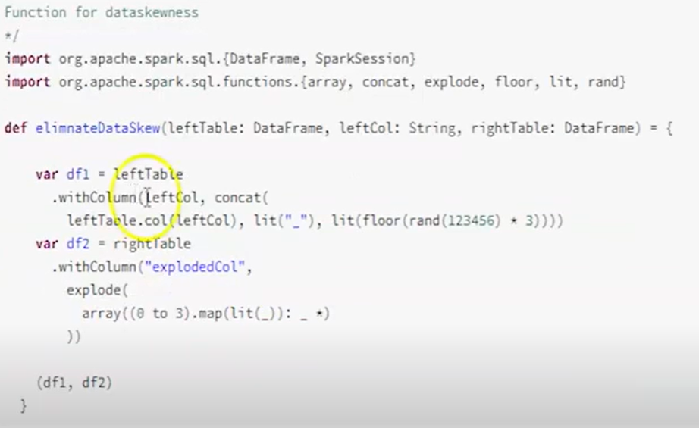
Notes:
Data Skew:
Data distributed storage
Data distributed processing or parallel processing.
1. Data skewness is a common problem in distributed processing.
2. Whenever a key occurs several times in a column and the same column is used in spark join this leads to Data skewness
Ex:
Table A – few million records (large dataset)
Table B – few hundred records (medium dataset)
Join Condition – A.id = B.id
Disadvantages/Issues:
Performace of Spark is impacted
Long running tasks
Under utilization of allocated resources
Resource idleness without performing any task.
Prevents enjoying the advantage of parallel, distributed processing
How to resolve?
Salting Technique
Table A – Concatenate with some character and append some random number between range
Ex: Key +_+Range(1,3)
Table B – Explode the value within some range
Explode(key, Range(1,3))-> x_1,x_2,x_3
Adaptive Query Execution in Spark 3.0
Workarounds to avoid data skewness in Spark 2.0
Repartition – increase the number of partition with equal size. But presence of single dominant partition won’t solve the skewness
Salting Technique -

Slide 17
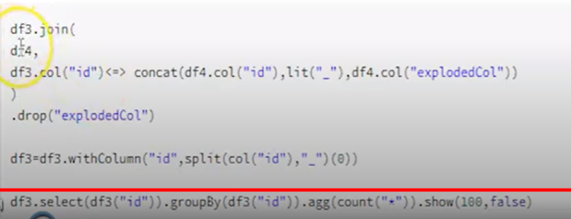

Slide 18
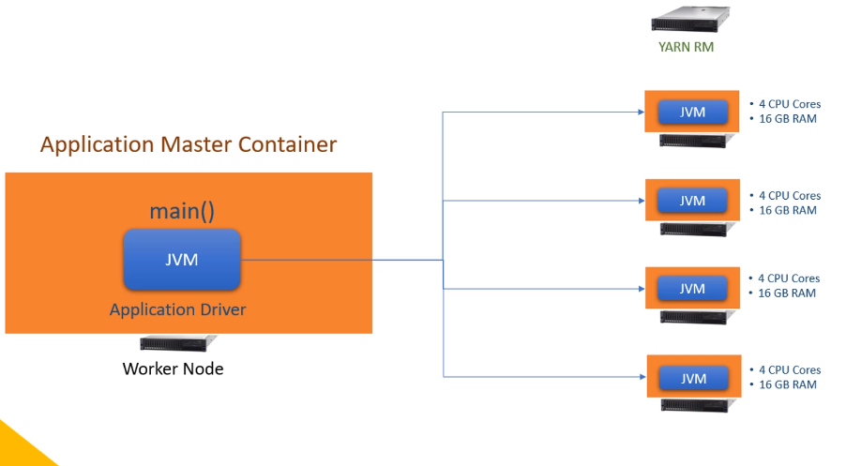
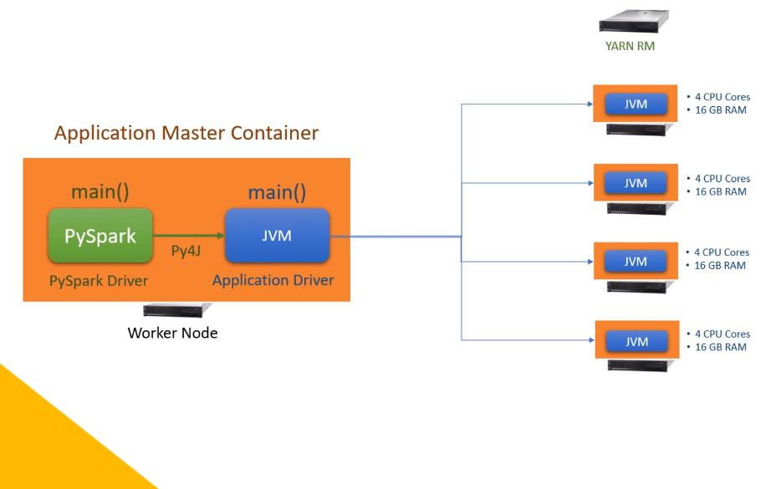
Spark Dataframe using Python will have one PySpark drive, one JVM driver and one or more JVM executors.
Spark Dataframe using Scala or Java will have one JVM driver and one or more JVM executors.

Slide 19
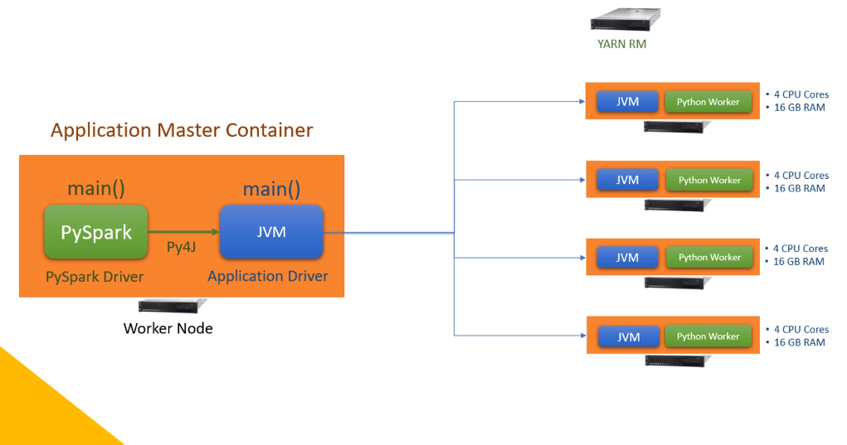
Even if you are creating UDFs in Python, your runtime architecture will look like this. So what is the difference?
You have a Python worker at each executor. What is a Python Worker, and Why do we need them?
Python worker is a Python runtime environment. And you need them only if you are using some python specific code or libraries.
PySpark is a wrapper on Java code. So as long as you are using only PySpark, you do not need a Python runtime environment.
All the PySpark code is translated into Java code, and it runs in the JVM. But if you are using some Python libraries which doesn't have a Java wrapper, you will need a Python runtime environment to run them.
So the executors will create a Python runtime environment so they can execute your Python code.
I will talk more about this in a later video.
But for now, let's remember that you may have Python workers inside the executor container for running custom python code outside the PySpark API.

Slide 20
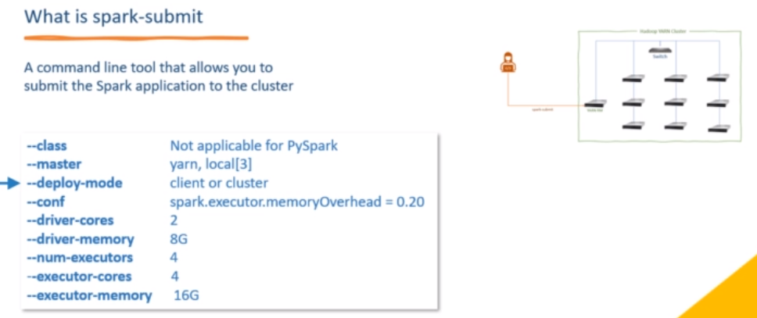
Spark-submit -- class <main-class> --master <master-url> --deploy-mode <deploy-mode> <application-jar> [application-args]
Spark-submit is a command line tool to submit spark application to the cluster
<application-jar> → application jar or pyspark script

Slide 21
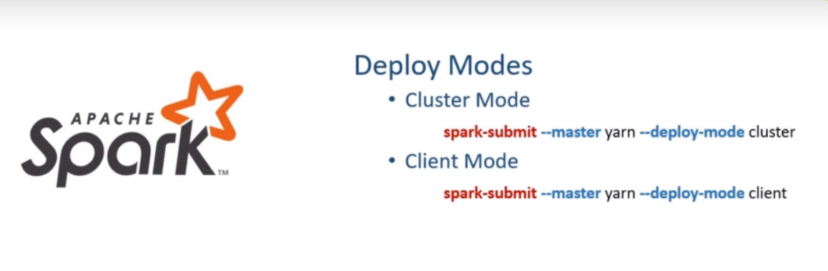
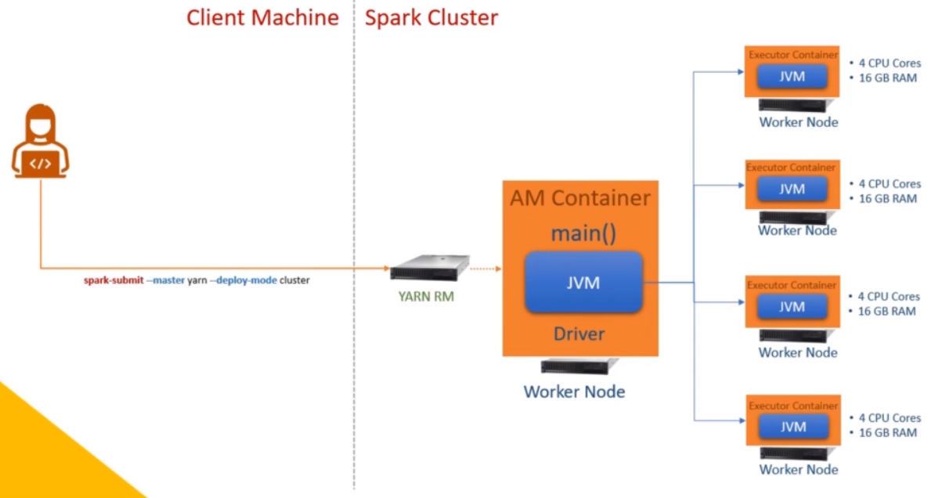
Deploy Mode

Slide 22
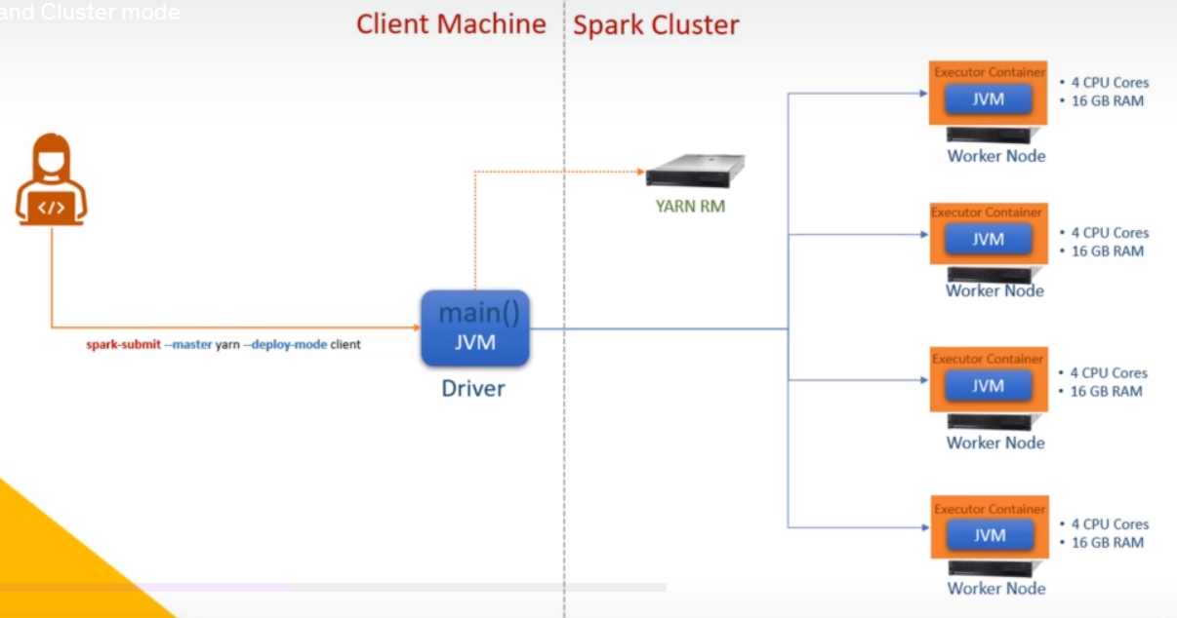

Slide 23
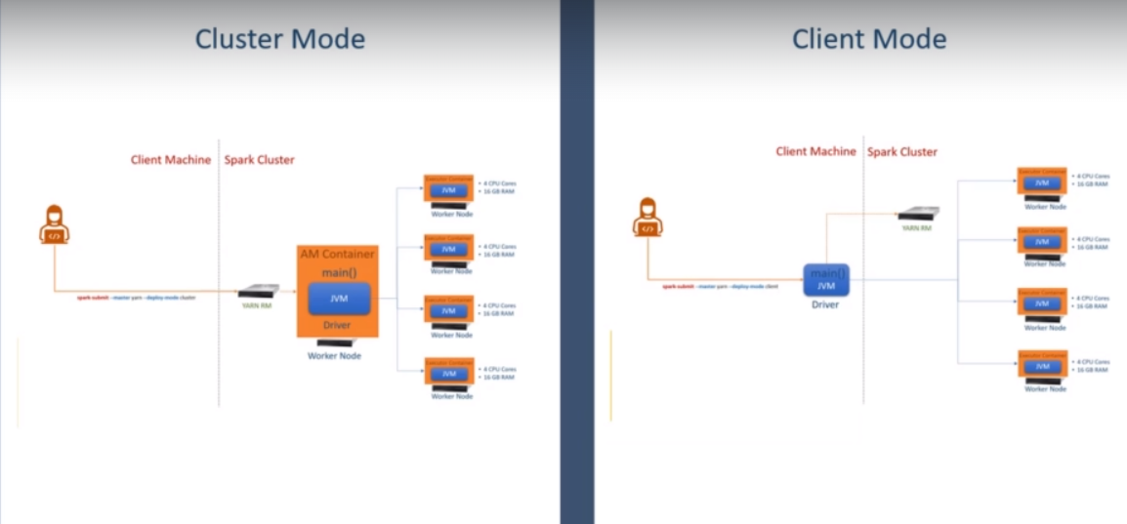

Slide 24
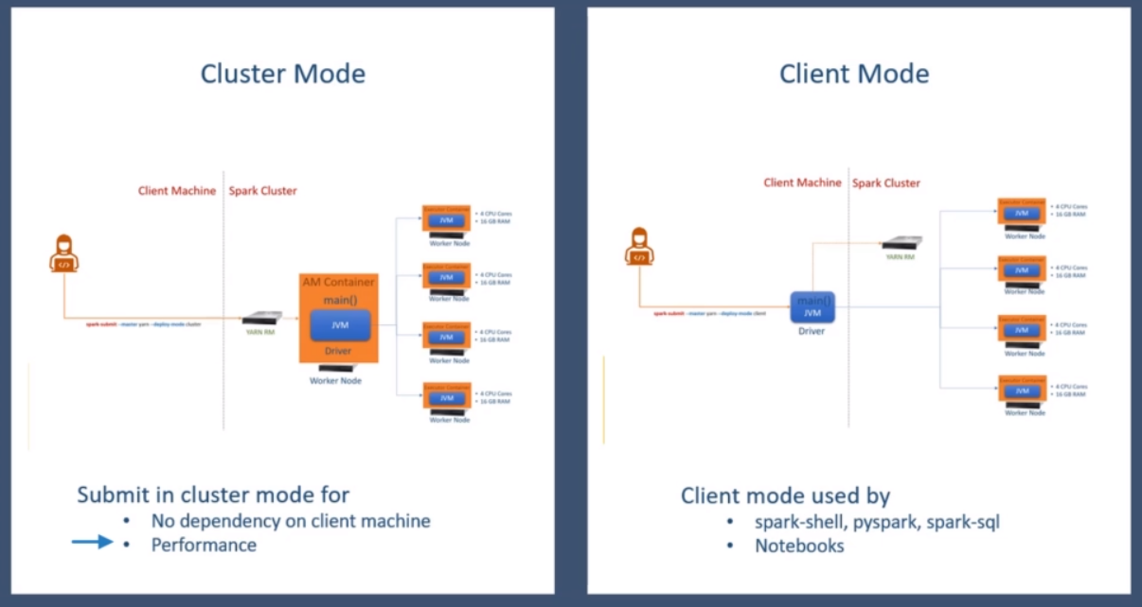

Slide 25
Understanding Spark jobs and stages require you to know about the Spark Dataframe API classification.
Most of the Spark APIs can be classified into two categories.
Transformations and Actions. We also have some functions and objects that are neither transformations nor actions.
However, the majority is grouped in these two categories.
Transformations are used to process and convert data, and they are further classified into two categories.
Narrow Dependency transformations - The narrow dependency transformations can run in parallel on each data partition without grouping data from multiple partitions.
For example, select(), filter(), withColumn(), drop() etc.
All these transformations can be independently performed on each data partition in parallel.
And you do not need to group data for performing these transformations.
Wide Dependency transformations - The Wide dependency transformations require some kind of grouping before they can be applied.
For example, groupBy(), join(), cube(), rollup(), and agg().
All these wide dependency transformations require grouping of data on some key
and then apply the transformation.

Slide 26
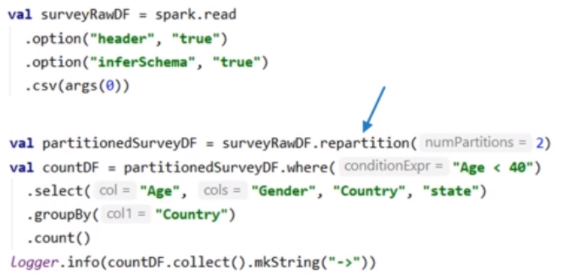
As the name suggests, an Action triggers some work, such as writing a Dataframe to disk, computing the transformations, and collecting the results. Some commonly used actions as read(), write(), collect(), and take() etc.
All spark actions trigger one or more Spark jobs. And that's a supercritical concept.
So now that we learned about the transformations and actions let's take an example code and see how spark runs our code. Here is a super simple spark application code snippet.
The initial surveyRawDF comes from reading a CSV file and inferring the schema. Then I am repartitioning the surveyRawDF and creating a new Dataframe. This new data frame is named partitionedSurveyDF.
I repartitioned it to make sure that I have two internal data partitions. And you should also know that the repartition() is a wide dependency transformation.
In the following line, I am taking a dataframe of two partitions and applying some transformations.
The first transformation is where() method, and that one is a narrow transformation.
Then I have a select() method, and this guy is also a narrow transformation. The third one is a groupBy(), and it is a wide dependency transformation.

Slide 27
This code snippet has got two spark code blocks. How do I know I have two blocks? That's simple. Start from the first line and look for action.
Wherever you find action, your first block ends there, and the following line starts a new block. In this example, my first line itself is an action.
The read() method is an action. So the first block starts at the first line, and it also ends at the first line. The following line starts a new code block.
Then I will keep looking for the action, but I find it only at the last line. So my second block starts from the second line and ends at the last line.
The point is straight. This example has got two code blocks. Why? Because we have two actions in this example.
A typical spark application looks like a set of similar code blocks. This example has got only two blocks, but a large application may have many code blocks. And spark will run each code block as one spark job.
What does it mean? Simple! Each action creates a spark job. And that's why we keep looking for actions to separate spark code blocks. I got two spark actions visible here. So I can assume two Spark jobs here. So I hope you understand the notion of Spark Jobs. It is as simple as each spark action runs as a spark job that contains all the transformations of its code block.
So in this example, let's leave the first block and concentrate on the second code block.

Slide 28
So here is my code block that terminates with a spark action. Your application driver will take this block, compile it and create a Spark job. But this job must be performed by the executors. Why? Because the driver doesn't perform any data processing job. The driver must break this job into smaller tasks and assign them to the executors. So how that happens? Let's see how our job looks like.
Here it is.
The job must start with surveyDF and repartition it to create partitionedSurveyDF. Then it must apply the four transformations to create the countDF. That's all we want to do as part of this job. Right? I ignored the collect action for now, and we will come back to it later.
So this is what we call the logical query plan of your spark job.
I will talk about query planning in a separate video, but you can get a sense here. Spark driver will crate a logical query plan for each spark job. Remember that.
And this example shows how the logical plan looks like. Once we have the logical plan, the driver will start breaking this plan into stages. Let's see how that happens.

Slide 29
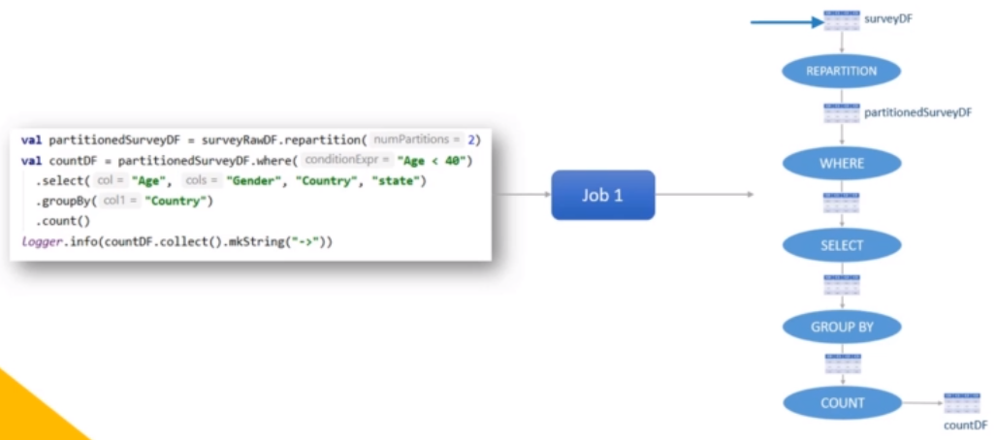

Slide 30
The driver will look at this plan to find out the wide dependency transformations. I have two wide dependencies in this plan.
The first one is the repartition() method, and the second one is the groupBy() method. So the driver will break this plan after each wide dependency.
The first one becomes the first stage. The second one goes to the second stage. Finally, the last one is the third stage.
So here we are. My logical plan is now broken down into three stages. Each stage can have one or more narrow transformations, and the last operation of the stage is a wide dependency transformation.
Spark cannot run these stages in parallel. We should finish the first stage, and then only we can start the next stage. Why?
Because the output of the first stage is an input for the next stage. Isn't it?
So whatever we see here is one spark job, and it is broken down into three stages. All the stages can run one after the other because the output of one stage is input for the next stage.

